Slide 1
Python week 8
Canberra Chinese School Sem1

Slide 2

Review (While loops)
while condition:
repeats something while the condition is true

Slide 3
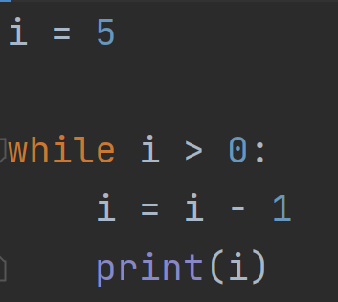
While loops
A. 4 3 2 1 0
B. 5 4 3 2 1 0
C. 4 3 2 1
D. 4 3 2 1 0
Answer: C

Slide 4
For loops (Review)
for x in range(n):
do something
This “something” repeats n times

Slide 5
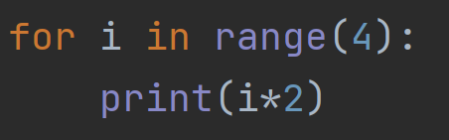
For loops
A. 1 2 3 4
B. 0 1 2 3
C. 2 4 6 8
D. 0 2 4 6
Answer: D

Slide 6
Review exercise
Make a countdown from 5 to 1 using
1. While loops
2. For loops

Slide 7
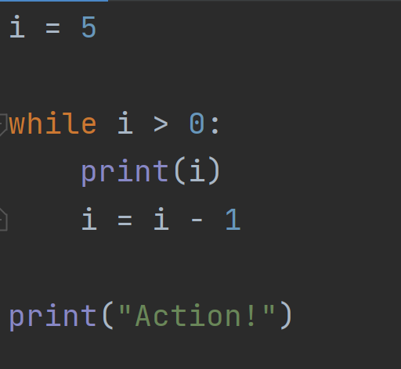
Review exercise (while loop answer)

Slide 8
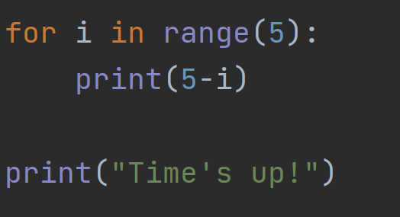
Review exercise (For loop answer)

Slide 9
Random numbers
At the top of the script, write:
import random
Then try:
print(random.randint(1,6))

Slide 10
Random numbers
This gives a random integer between 1 and 10
(including 1 and 10)
random.randint(1,10)

Slide 11
Random numbers
This gives a random integer between 15 and 25
random.randint(15,25)

Slide 12
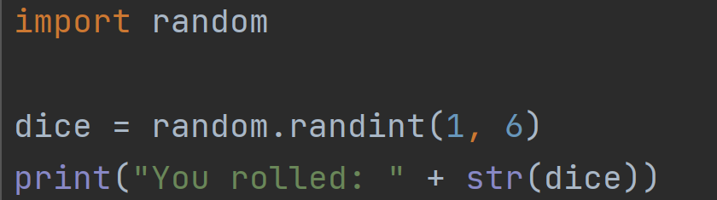
Random numbers
Throwing a dice:

Slide 13
Random numbers
This picks a random item from a list
random.choice(list)

Slide 14
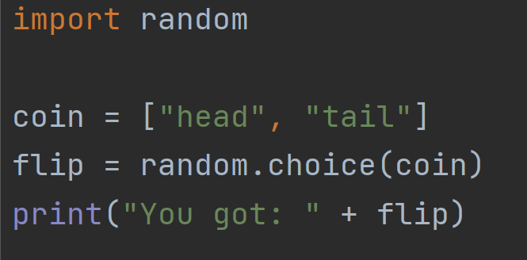
Random numbers
Flipping a coin:

Slide 15
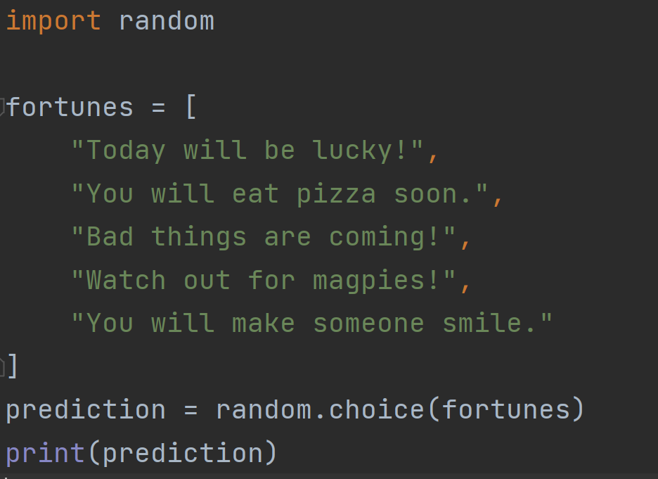
Random numbers

Slide 16
Functions
def function_name():
do something
A function combines complicated steps into one command.
It can be used multiple times.

Slide 17
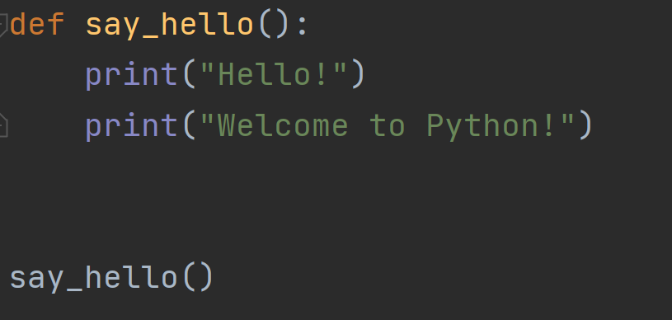
Functions

Slide 18
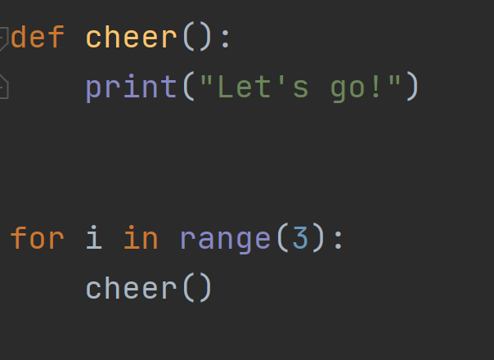
Functions

Slide 19
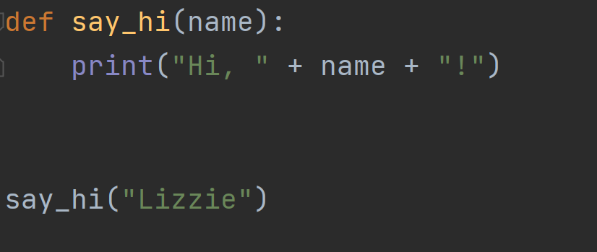
Functions with parameters

Slide 20
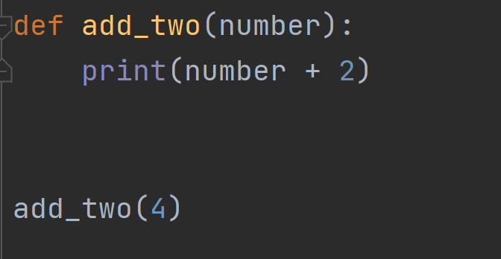
Functions with parameters

Slide 21
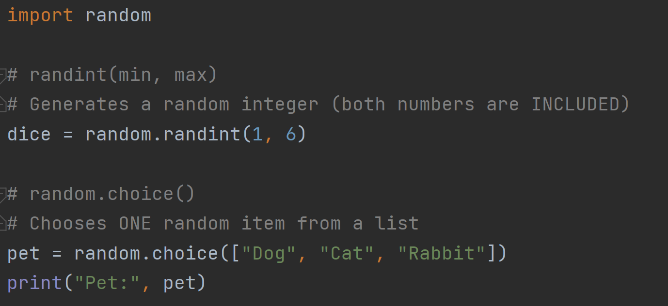
Summary (random)

Slide 22
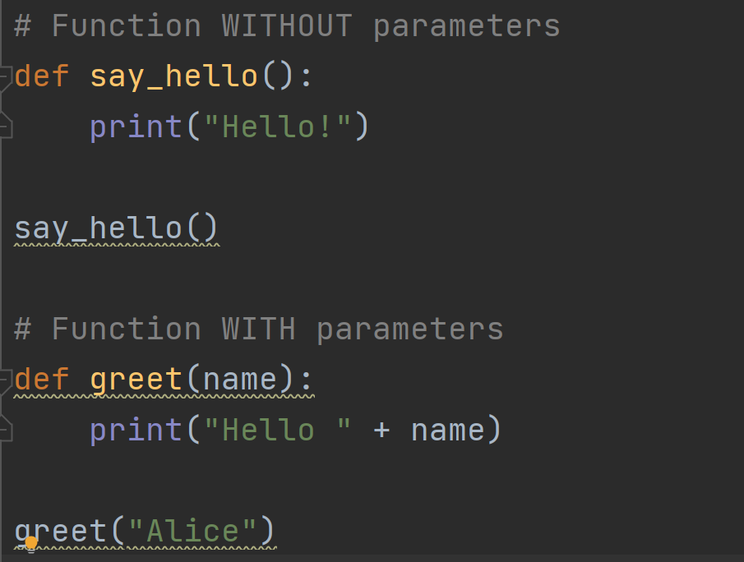
Summary (functions)

Slide 23
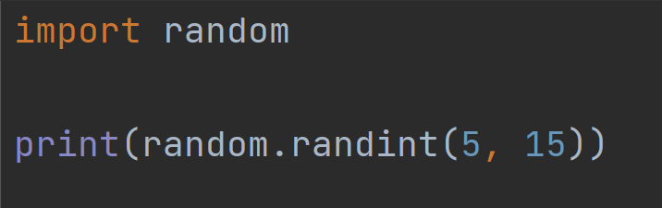
Quiz 1
Answer: B
What is the smallest possible number that can be printed
A. 4
B. 5
C. 6
D. 15

Slide 24
Quiz 2
Answer: c
Which line correctly creates a function?
A. function hello():
B. create hello():
C. def hello():
D. make hello():

Slide 25
Quiz 3
Answer: C
How do you call (use) a function called “jump”?
A. jump
B. do jump()
C. jump()
D. jump[]

